Slide 1

Analysis, Key Insights and
Recommendations Report for Lakeman Global Online Retail
Insights on Sales Performance, Shipping Trends, Customer Behaviour and Operational Efficiency of Lakeman Global from January 2021 to January 2024

Slide 2
Outline
Introduction
Problem Statement
Research Objectives
Research Questions
Dashboard Overview
Insights
Recommendations
Conclusion

Slide 3

INTRODUC-TION
To help make smarter decisions on inventory, marketing, shipping, and growth, the Lakeman Global Online Retail, a world leading business that has existed for over a decade wants their last four (January 2021 to January 2024) financial years of data analysed to tracks sales, profit, customer behaviour, product performance, and shipping efficiency across all regions.

Slide 4
PROBLEM
STATEMENT
Carry out prescriptive analysis on the sales data given. The analysis aims to help the company make better decisions on inventory, marketing, shipping and growth moving forward.

Slide 5
RESEARCH
OBJECTIVES
Analyse the sales data received from Lakeman Global Online retail.
Uncover the insights that matter most: where the money is made, where it’s lost, who the best customers are, what’s selling, what’s not, and why.
Build an interactive dashboard for the company to understand sales performance and operational efficiency.

Slide 6
RESEARCH
QUESTIONS
What are our total sales across all regions (top 10)?
Which product categories are driving the majority of our sales growth, and which are stagnating or in decline?
What is the total sale in each region?
What is the total sale in each department?
Which customer segments are underperforming, and what strategies can we implement to boost their sales?
What are the key drivers behind our best-selling products, and how can we leverage them for future launches?

Slide 7
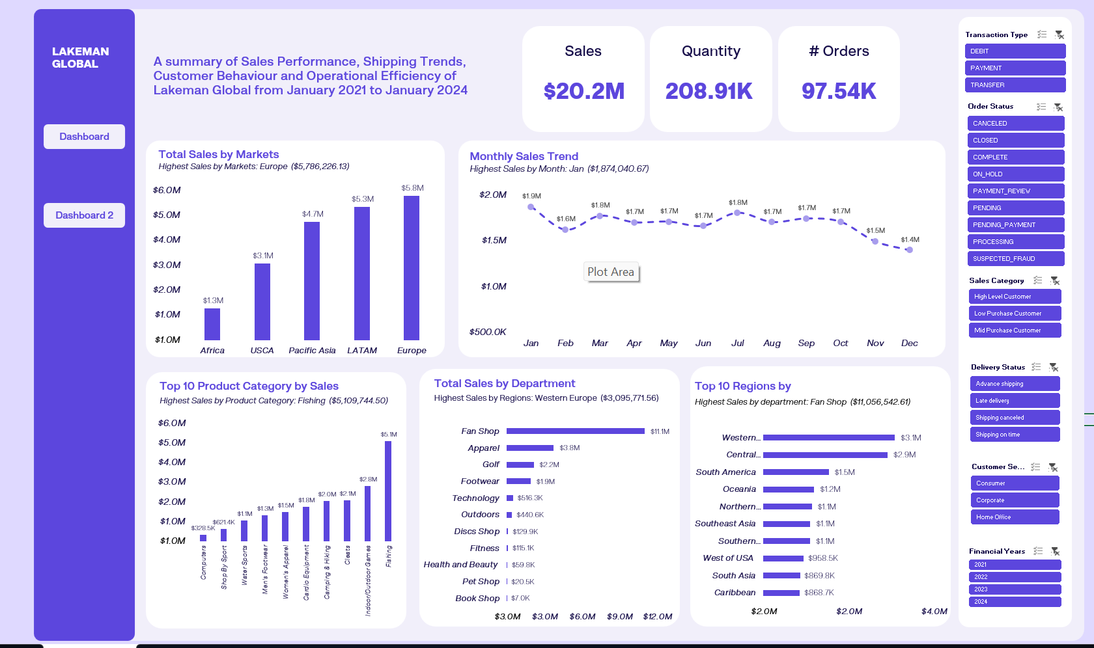
Dashboard Overview

Slide 8
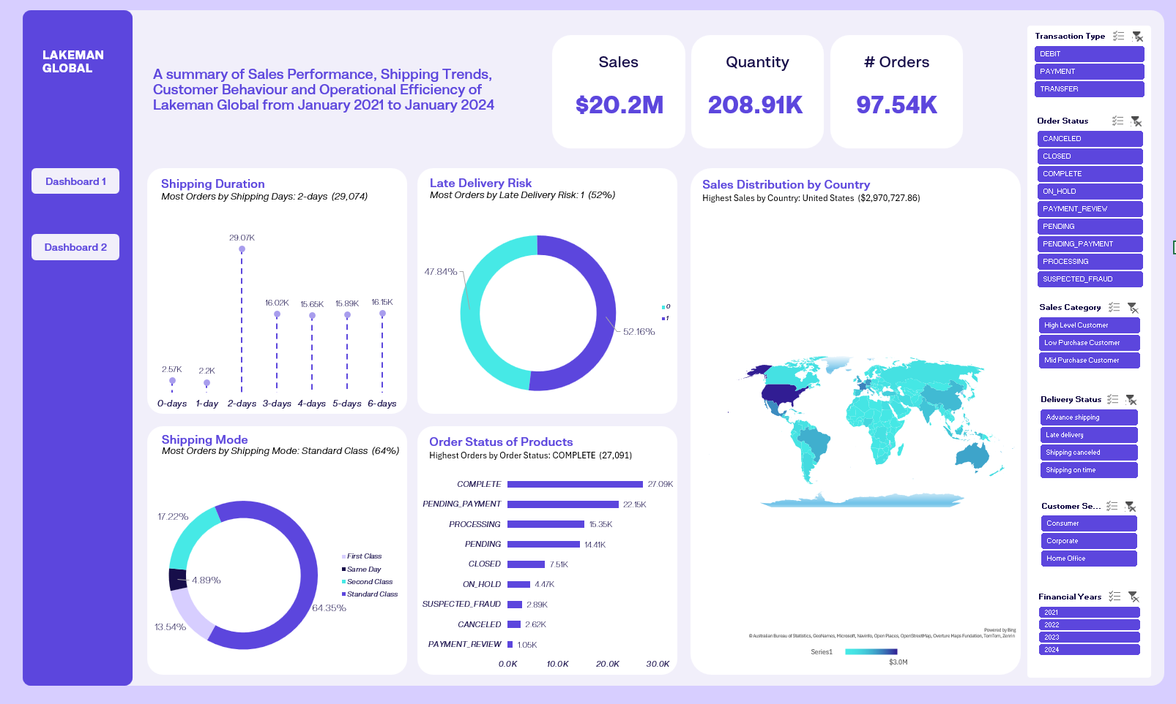
Dashboard Overview

Slide 9

Insights
Top 10 Regions by Sales
Top Regions by Sales:
Based on this analysis, the region with the highest sales is Western Europe with a total of $3.1 Million with the least being Central Asia with a total of $60.1 thousand.
Highest Sales by department: Fan Shop ($11,056,542.61)

Slide 10
Insights
Top 10 Product Category by Sales
Highest Sales by Product Category: Fishing ($5,109,744.50)
Top Product Category by Sales:
The product category with the highest sales is Fishing with a total of $5.1 Million with the least being CDs with a total of $1.8 thousand. This is due to customers preferring fishing products the most.

Slide 11
Insights
Monthly Sales Trend
Highest Sales by Month: Jan ($1,874,040.67)
Monthly Sales Trend:
January shows the most sales with a value of $1.9 million showing that the start of the year brings about the most sales with December being the least with a value of $1.4 million.

Slide 12
Insights
Total Sales by Markets
Highest Sales by Markets: Europe ($5,786,226.13)
Market Sales Trend:
The analysis shows that Europe is the market with the largest sales valued at $5.8 million and Africa being the smallest valued at $1.3 million.

Slide 13
Insights
Total Sales by Department
Highest Sales by Regions: Western Europe ($3,095,771.56)
Departmental Sales:
The analysis shows that Fan Shop is the department with the largest sales valued at $11.1 million and Book Shop being the smallest valued at $7.0 thousand.

Slide 14
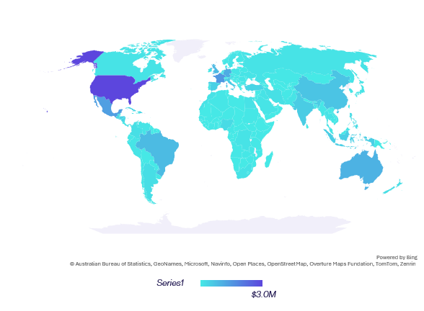
Insights
Sales Distribution by Country
Highest Sales by Country: United States ($2,970,727.86)
Sales by Country:
The analysis shows that the United States of America (USA) is the country with the largest sales valued at $2.97 million and South Sudan in Africa being the smallest valued at $49.98.

Slide 15
Insights
Order Status of Products
Highest Orders by Order Status: COMPLETE (27,091)
Product Order Status:
The COMPLETED orders are the most valued at 27.09 thousand orders and the least being PAYMENT_REVIEW with 1.05 thousand still having pending payments.

Slide 16
Insights
Shipping Mode
Most Orders by Shipping Mode: Standard Class (64%)
Shipping Modes:
The shipping mode most used is the standard class with 64.35% of the total shipping modes used by Lakeman Global Online Retail.

Slide 17
Insights
Late Delivery Risk
Most Orders by Late Delivery Risk: 1 (52%)
Late Delivery Risk:
The orders with the least delivery risk ranks slightly higher than orders with more late delivery risk being valued at 52.16% of the total.

Slide 18
Insights
Shipping Duration
Most Orders by Shipping Days: 2-days (29,074)
Shipping Duration:
Based on the analysis done, the 2-day shipping duration ranks highest at 29.07 thousand orders and the least as the 1-day duration with its value as 2.2 thousand orders.

Slide 19
RECOMM-
ENDATIONS
Reduce late delivery risk drastically by ensuring on-time delivery of products.
Provide targeted and personalised promotions to improve sales in underperforming regions, markets and product categories.
Ensure that all orders are viewed and attended to on time to improve the completed order status quantity.
All pending payment and on-hold orders should be efficiently reviewed and attended to.
Low Purchase Customers can be encouraged to buy products with higher prices to increase sales through special discounts and promotions.
Based on the monthly sales trend, further research should be done to find out why sales are the least in December.

Slide 20
CONCLU-
SION
The Lakeman Global Retail Sales performance and operational efficiency analysis reveals significant insights into sales performance, shipping trends, customer behaviour and operational efficiency. By increasing sales of different product categories, reducing late delivery risk, Improving lower reached markets such as Africa, improving customer experience by providing discount incentives to their Low Purchase Customers and personalised promotions for all customers to increase their purchase power as well as ensuring that departments that are not functioning well start to function better, the company can improve their sales performance, the behaviour of customers and operational efficiency.

Slide 21
Thank You!

